Slide 1
LAW ENFORCEMENT: PROMOTING OR IMPEDING LOCAL ECONOMIC DEVELOPMENT?
Presented by:
Danie Nel

Slide 3
We will look at......
Law enforcement in general;
Law enforcement and local economic development
National and Municipal Perspective;
Suggestions;

Slide 4
Law enforcement in general
“Crime casts fear into the hearts of South Africans from all walks of life and prevents them from taking their rightful place in the development and growth of our country. It inhibits our citizens from communicating with one another freely, from engaging in economic activity and prevents entrepreneurs and investors from taking advantage of the opportunities which our country offers.”
(National Crime Prevention Strategy – Summary)

Slide 5
Current state
Law enforcement in general is not effective;
- Lack of understanding of legislation and mandates at all levels;
Officials not properly trained/appointed to enforce;
Lack of equipment to enforce;
Constitutional functions not properly defined, resulting in buck passing (grey areas – especially i.r.o. environmental legislation)
Poor docket and case management;
Corrupt officials;
“The public servants most associated with corruption both for the citizens and the businesses appear to be the police. All surveys indicate that police officers are the most vulnerable to corruption, followed by customs, local government, home affairs and court officials;” (Corruption assessment report – 2003)

Slide 6
Current State cont….
No accountability;
Lack of management support in enforcement processes – (Legal admin., interdicts, etc.);
Lack of co-operation/support from local prosecutors , courts and SAPS;
Intergovernmental Relations Framework Act;
Law enforcement not proactive, mostly reactive;
Political interference;
The result? total disregard for the law
- Donkie Booysen shooting at Cape Town International;
- Daylight high jackings and robberies on highways;
- Shootings at night clubs in Stellenbosch and Cape Town;

Slide 7
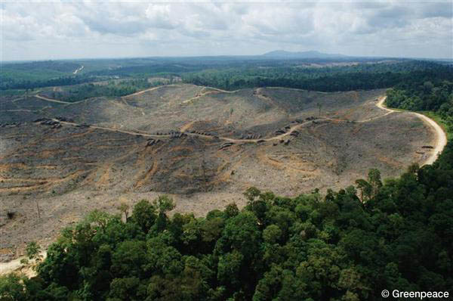
National Perspective
Forestry:
- destruction of natural resources denying communities within forestry areas opportunities for employment;
- environmental/economic impact of forests destroyed;
- impact on tourism, etc

Slide 8
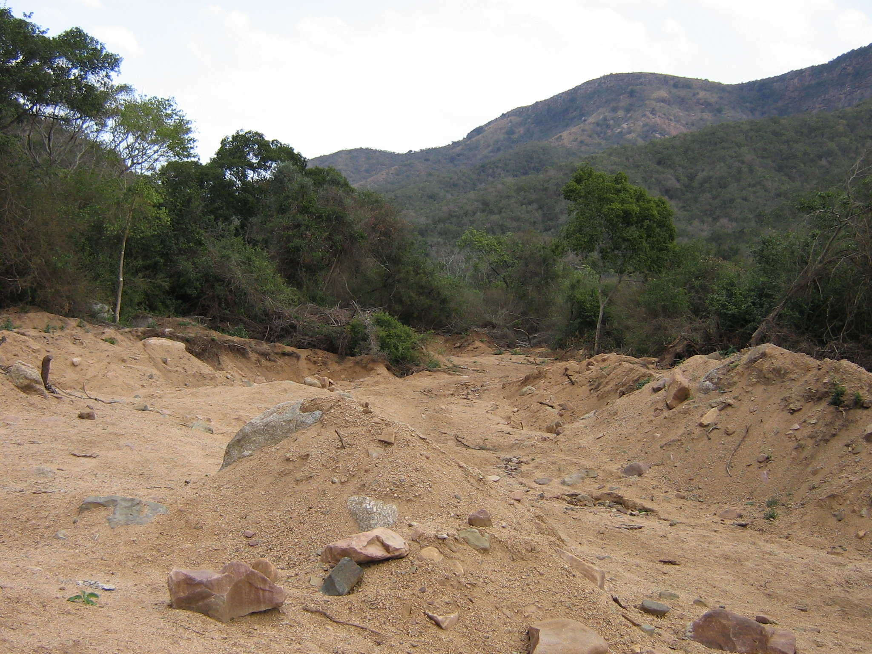
National Perspective cont….
Environment
Air pollution – diseases caused and medical costs;
Water pollution – diseases caused and again medical costs;
Illegal mining operations, economic impact, etc.

Slide 9
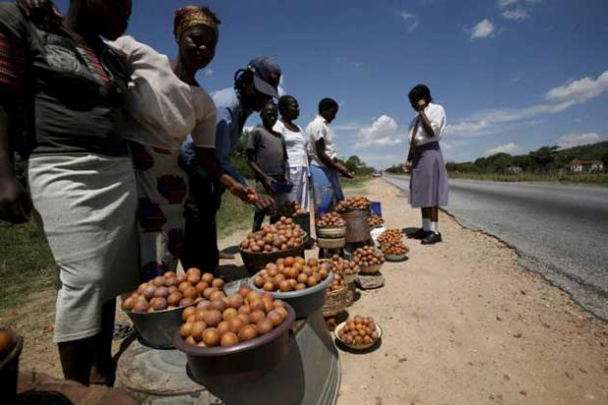
National Perspective cont…..
Agriculture:
Economic impact of products stolen from farms, stock theft, etc,
Cost of security systems to protect;
Loss of employment opportunities, etc.

Slide 10
Municipal perspective
Local Government turnaround strategy:
- Review all by-laws that are not contributing to development;
- Qualified and skilled staff to be appointed to oversee the implementation of by-laws;

Slide 11
WHY DO MUNICIPALITIES LEGISLATE?
Constitutional powers granted in terms of sec. 156 of Constitution (Fedsure case);
Policies not enforceable in court;
Systems Act obligates municipalities to adopt by-laws to give effect to policies; ( credit control & tariffs, rates)
Municipalities exercise legislative an executive authority through implementation and administration of by-laws and legislation to govern on their functional areas; (Sec 11 Systems Act)

Slide 12
Constitutional mandate of municipalities
“The objects of local government are-
(a) to provide democratic and accountable government for local communities
(b) to ensure the provision of services to communities in a sustainable manner
(c) to promote social and economical development
(d) to promote a safe and healthy environment
(e) to encourage the involvement of communities and organizations in the matters of local government”

Slide 13
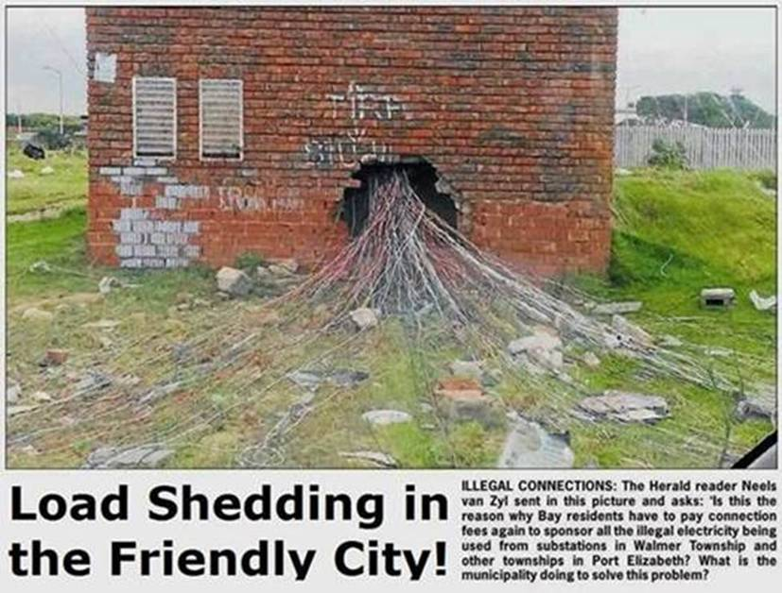
Municipal examples
Illegal use of electricity;
- Loss of revenue;
- Cost of replacing damaged infrastructure;

Slide 14
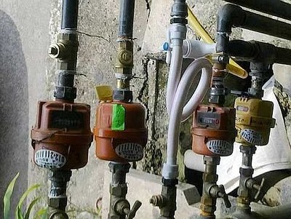
Municipal examples cont…
Illegal use of water
- loss of revenue;
- cost of replacement of infrastructure

Slide 15
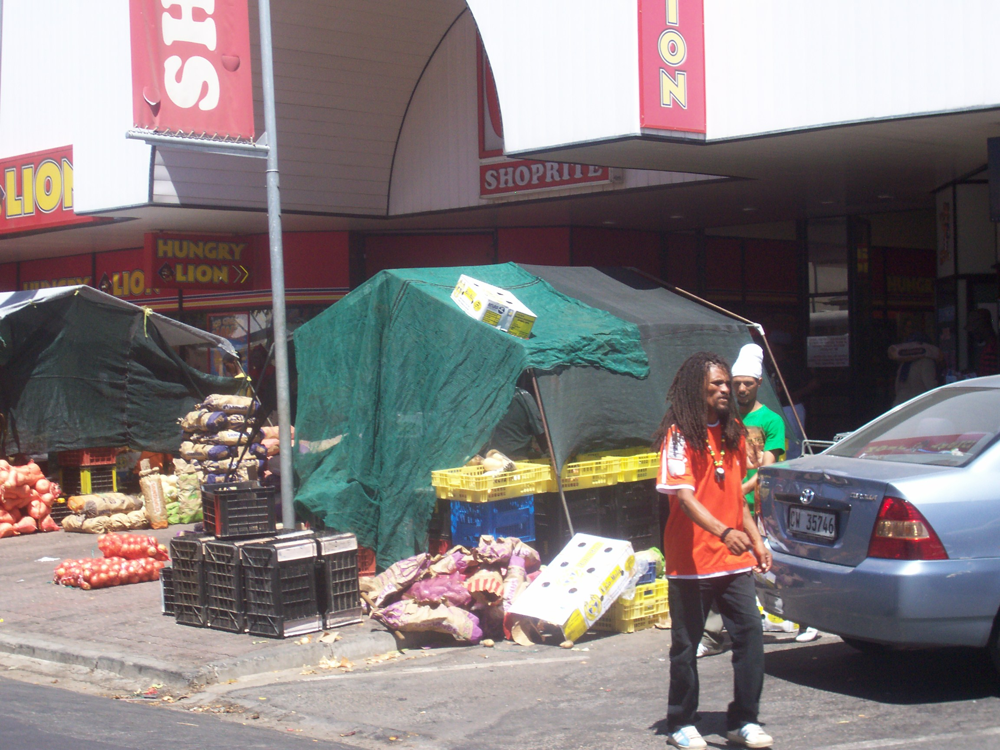
Municipal examples cont…..
Uncontrolled informal trading;
- loss of opportunities for local traders;
- cost of cleaning up operations;
- promotion of trading in counterfeit goods;

Slide 16
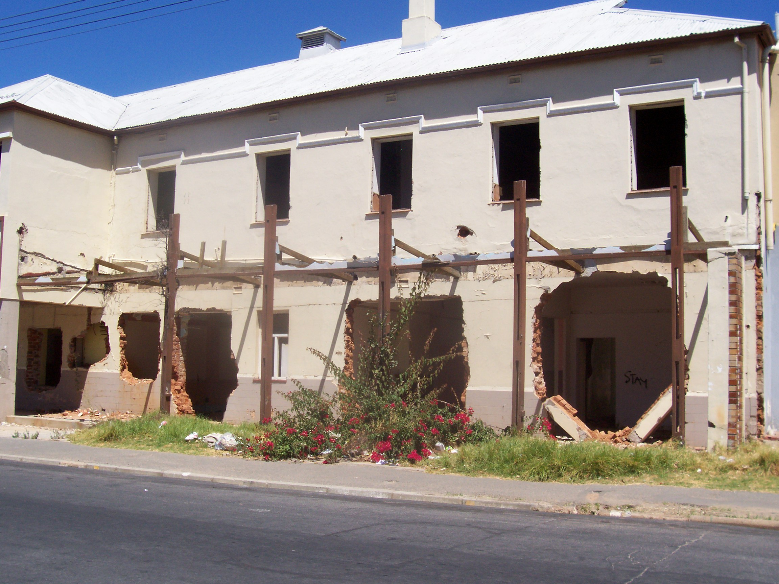
Municipal examples cont….
Urban decay & building control
- decline in property values;
- businesses re-locating;
- loss of jobs;
- loss of investment opportunities;
(CCID example)

Slide 17
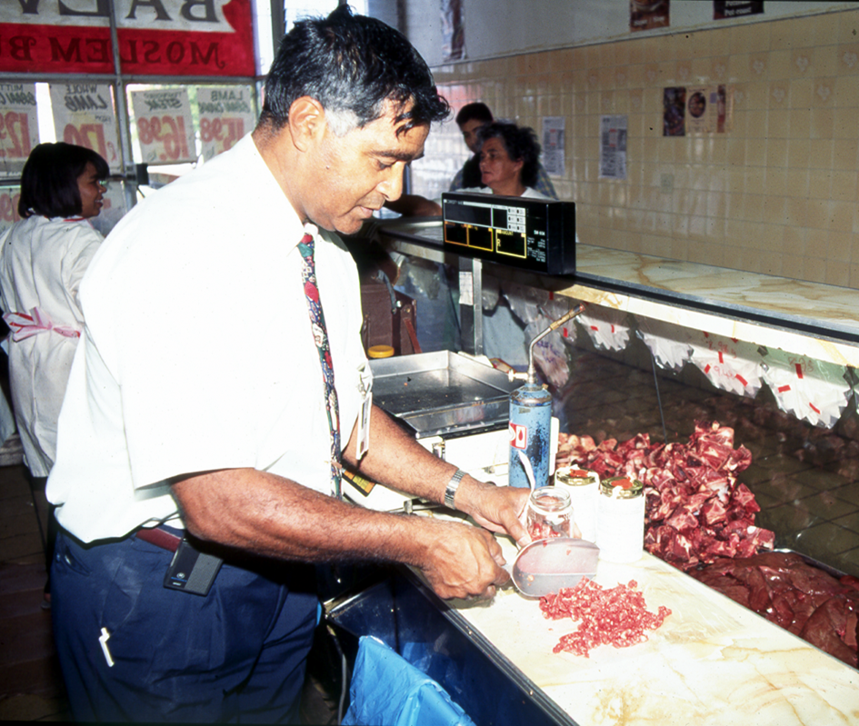
Municipal examples cont…..
Municipal Health;
Food control;
Waste management;
- industrial waste,
- medical waste;
Environmental pollution;
- air quality
- ground pollution
- water pollution

Slide 18
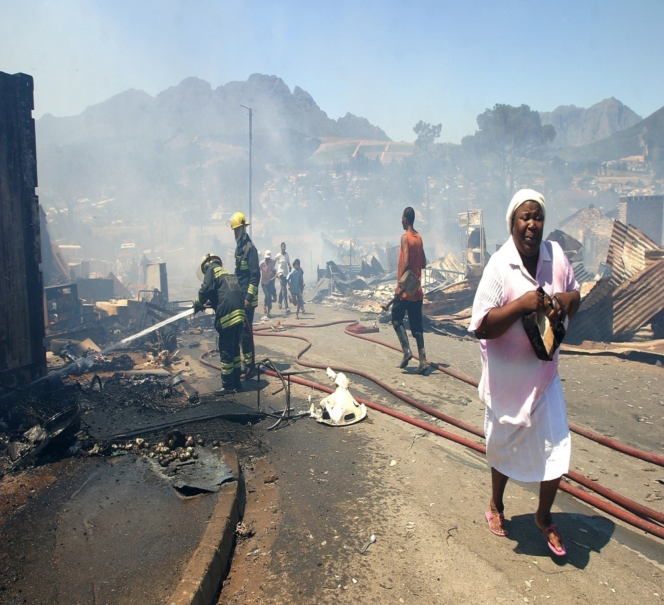
Municipal examples cont….
Fire Safety
- pro active or re-active?
- cost of fire fighting operations;
- loss of jobs – and life;
- impact on insurance industry;

Slide 19
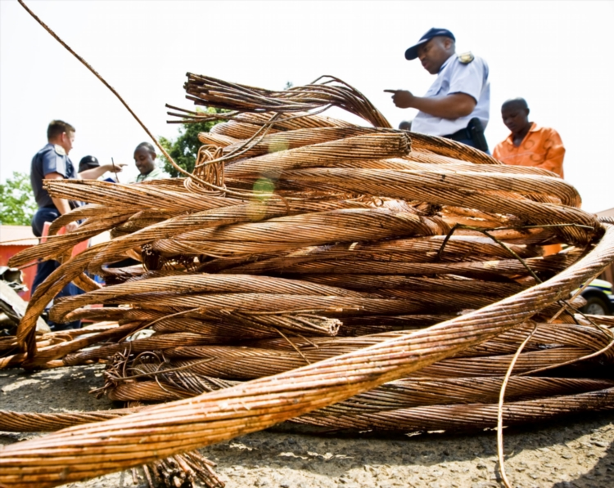
Municipal examples cont…..
Second Hand Goods Act, 2009
Municipalities loose millions per annum through cable theft, manhole covers, fittings, etc.
Impact on business operations, transport, etc.
Yet dealers still operate;

Slide 20
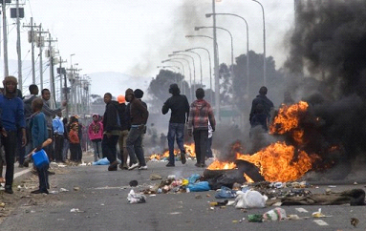
Municipal examples cont…..
Violent protests- Why?
- not always politically inspired;
- lack of meaningful engagement with communities in decision making?;
- poor service delivery;
- impact on local economic development (libraries, community halls & municipal buildings)

Slide 21
Suggestions??
LED strategies should realise that for residents to be productive in the economy, they need to be healthy, skilled, and that their basic needs be taken care of;
Crime reduction through environmental design;
Develop & implement by-laws with a purpose;
- estuary management (Bergrivier – promoting economic opportunities through protection of environment and marine living resources but at the same time providing for local fishermen to access resources)
- building by-law – (Swartland – enhanced revenue to provide services and quality control)
- special rating areas (Breede Valley – promoting economic development through investment opportunities because of crime reduction and enhanced service delivery)
Establishment of municipal courts with dedicated prosecutors who are trained to understand municipal legislation – regional courts for smaller municipalities??

Slide 22
Solutions cont….
Quality training and capacitation of enforcement officials;
Multi agency approach – not forgetting to include the communities that are affected.

Slide 23
THANK YOU!
Danie Nel
danie@munstelcw.co.za
Mobile: 084 580 3309

Slide 24
References
Local Government Turnaround Strategy – http://lgict.org.za/document/local-government-turnaround-strategy-lgtas-2009
National Crime Prevention Strategy - https://www.gov.za/documents/national-crime-prevention-strategy-summary
National environmental Health Policy - https://cer.org.za/virtual-library/policy/national-environmental-health-policy-2013

